Slide 1

A+ Guide to Managing and Maintaining your PC, 6e
Chapter 11
Installing Windows 2000/XP

Slide 2
Objectives
Learn about Windows 2000/XP features and architecture
Learn how to plan a Windows 2000/XP installation
Learn the steps to install Windows XP
Learn what to do after Windows XP is installed
Learn how to install Windows 2000 Professional

Slide 3
Introduction
Windows 2000 and Windows XP are similar
Windows 2000
True 32-bit, module-oriented operating system
Improved security
User-friendly Plug and Play installations
Windows XP
Extra support for multimedia, PnP, legacy software
Merges Windows 9x/Me and Windows NT
Current choice as Windows OS for a PC
Only Windows OS for which you can buy a license

Slide 4
Features and Architecture of Windows XP
Topics to cover in this section
Various versions of Windows 2000/XP
Operating modes used by Windows
Networking features in Windows
How Windows manages hard drives and file systems
Appropriate uses of Windows XP or Windows 2000

Slide 5
Versions and Features of Windows XP and 2000
Windows XP (Home Edition and Professional)
New user interface with new look and feel
Ability to simultaneously log on two or more users
Windows Media Player and Windows Messenger
Windows Security Center (with Service Pack 2)
User-friendly CD burning process
Remote Assistance and expanded Help
Windows XP Professional offers additional features
Example: support for new higher-performance CPUs

Slide 6
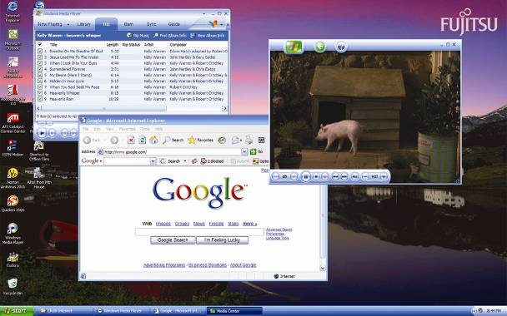
Figure 11-1 New user interface and sample windows

Slide 7
Versions and Features of Windows XP and 2000 (continued)
Two systems built on Windows XP Professional
Windows XP Media Center Edition
Windows XP Tablet PC Edition
Windows XP Professional x64 Edition
Used with 64-bit processors such as Intel Itanium
Windows 2000 includes four operating systems:
Windows 2000 Professional
Windows 2000 Server
Windows 2000 Advanced Server
Windows 2000 Datacenter Server

Slide 8
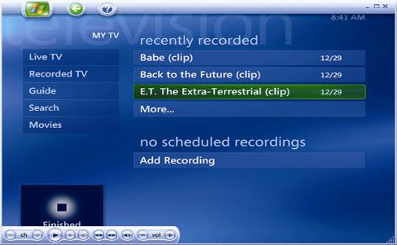
Figure 11-4 Media Center is set to watch live TV, record TV, search your online TV guide, and play movies

Slide 9
Windows 2000/XP Architecture and Operating Modes
Two operating modes used: kernel and user
User mode
Several subsystems that interact with users/programs
All applications relate to the OS via Win32 subsystem
Each DOS application runs on its own NTVDM
16-bit Windows 3.x apps run in a WOW environment
32-bit applications interact directly with OS (protected)
Process: running program or group of programs
Thread: single task that process requests from kernel
A process can spawn multiple threads

Slide 10
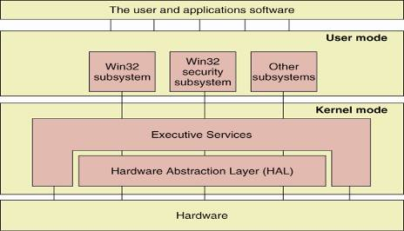
Figure 11-6 User mode and kernel mode in Windows 2000/XP and how they relate to users, application software, and hardware

Slide 11
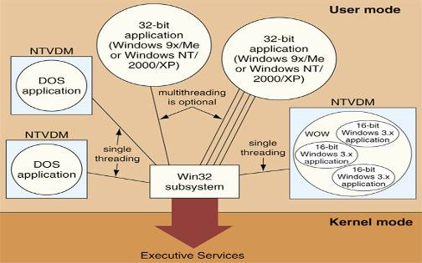
Figure 11-7 Environment subsystems in Windows 2000/XP user mode include NTVDMs for DOS and Windows 3.x applications and optional multithreading for 32-bit applications

Slide 12
Windows 2000/XP Architecture and Operating Modes (continued)
Kernel mode
Comprises HAL and Executive services
HAL (hardware abstraction layer) interacts with CPU
Executive services manage hardware resources
Applications in user mode cannot access hardware
Benefits of dividing OS into user and kernel modes
HAL and Executive services operate more efficiently
Application address space is protected
System is protected from illegal demands

Slide 13
Networking Features
Workgroup: logical group of computers and users
Resources are shared within a workgroup
Administration is decentralized
Workgroup uses a peer-to-peer networking model
Domain: group of networked computers
Resources are controlled via a centralized directory
A domain uses a client/server networking model
Network operating system (NOS) controls directory
Some NOSs: Windows Server 2003, Novel NetWare

Slide 14
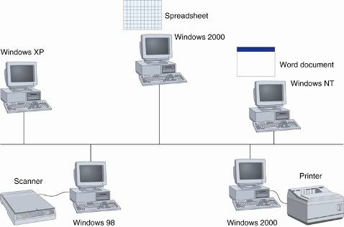
Figure 11-9 A Windows workgroup is a peer-to-peer network where no single computer controls the network and each computer controls its own resources

Slide 15
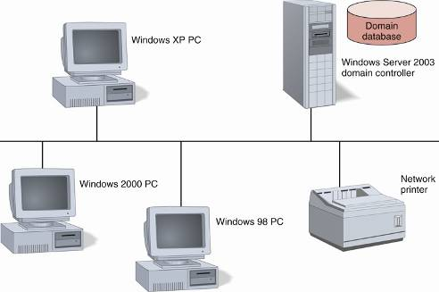
Figure 11-10 A Windows domain is a client/server network where security on each PC or other device is controlled by a centralized database on a domain controller

Slide 16
Networking Features (continued)
Windows domains
Security accounts manager (SAM) database contents
User accounts, group accounts, computer accounts
Domain controller stores and controls SAM
Primary domain controller (PDC) holds original directory
Backup domain controller (BDC) holds read-only copy
Native mode: only Windows 2000 PDCs in the system
Mixed mode: at least one Windows NT PDC in system
Active directory: single point of control over network
Active Directory includes the SAM database

Slide 17
Networking Features (continued)
Windows 2000/XP Logon
Administrator account
Has rights and permissions to all computer resources
Used to set up other user accounts and assign privileges
Logon is required before OS can be used
Rights and permissions granted according to user group
Windows XP allows multiple users to be logged on
To logoff or switch to another user, press Ctrl-Alt-Del
Log Off Windows dialog box appears

Slide 18
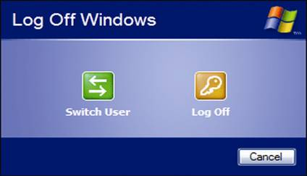
Figure 11-11 Switch users or log off in Windows XP

Slide 19
How Windows 2000/XP Manages Hard Drives
Hard drive organization: partition, logical drive, sector
Steps involved in logically organizing a drive:
Cylinders on the drive are divided into partitions
Partition table defines where partition begins and ends
Partitions are divided into logical drives; e.g., C, D, E
Creating first two levels is called partitioning the drives
Each logical drive is formatted with a file system
Some file systems used: FAT16, FAT32, or NTFS
Master Boot Record (MBR) or master boot sector
Contains master boot program and the partition table

Slide 20
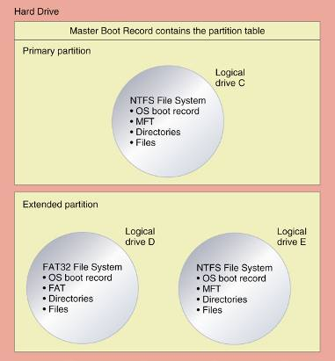
Figure 11-12 A hard drive is divided into one or more partitions that contain logical drives

Slide 21
Table 11-1 Hard drive MBR containing the master boot program and the partition table

Slide 22
How Windows 2000/XP Manages Hard Drives (continued)
Actions performed by master boot program at POST:
Integrity of partition table is checked
Active (system) partition is located
OS boot program in active partition is executed
Types of partitions in Windows 2000/XP
Primary: has only one logical drive, such as drive C
Extended: can have multiple logical drives; e.g., D, E
Up to four partitions allowed in Windows 2000/XP
The active partition is always a primary partition
There can only be one extended partition

Slide 23
How Windows 2000/XP Manages Hard Drives (continued)
System partition: active partition with OS boot record
Boot partition: store Windows 2000/XP OS
System and boot partitions are usually the same
Each logical drive is formatted with a file system
FAT16
16-bit cluster entries
A cluster contains four 512-byte sectors (2,048 bytes)
Minimum of one cluster per file
Slack: wasted space in a cluster (not used by small file)

Slide 24
How Windows 2000/XP Manages Hard Drives (continued)
FAT32
Each FAT contains 32 bits per FAT entry
Only 28 bits are used to hold a cluster number
Cluster sizes range between 8KB to 16KB
NTFS (New Technology File System)
Master file table (MFT): index for files and directories
Small data files can be contained in the MFT itself
Large data files are pointed to by extended attribute
Range of cluster sizes: 512 bytes to 4KB

Slide 25
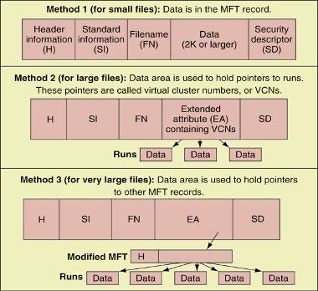
Figure 11-17 The NTFS file system uses a master file table to store files using three methods, depending on the file size

Slide 26
How Windows 2000/XP Manages Hard Drives (continued)
Some advantages of NTFS over FAT
NTFS is a recoverable file system
NTFS under supports encryption and disk quotas
Advantages of FAT over NTFS
FAT is better for hard drives < 500 MB (low overhead)
FAT is compatible with Windows 9x/Me and DOS
Some reasons for more partitions and logical drives
You are creating a dual-boot system (two OSs)
To improve data organization; e.g., a drive for backup

Slide 27
Table 11-2 Size of some logical drives compared to cluster size for FAT16, FAT32, and NTFS

Slide 28
When to Use Windows 2000 and Windows XP
Advantages of Windows XP over Windows 2000
Greater stability
Easier installation
Increased security
Better driver support
When to retain Windows 2000
The OS was included with a notebook

Slide 29
Plan the Windows 2000/XP Installation
Careful planning will improve the installation process
Preparatory steps:
Verify that the system hardware can support the OS
Decide about Windows 2000/XP installation option
Decide how the drive will be partitioned and formatted
Decide how your computer will connect to a network
Decide how the installation process will work
Use a checklist to verify steps have been completed

Slide 30
Table 11-3 Minimum and recommended requirements for Windows XP Professional

Slide 31
Minimum Requirements and Hardware Compatibility
Questions to ask to verify system specifications:
What CPU and how much RAM is installed?
How much hard drive space is available?
Does my motherboard BIOS qualify?
Will my software work under Windows 2000/XP?
Will my hardware work under Windows 2000/XP?
What if I can’t find the drivers?

Slide 32
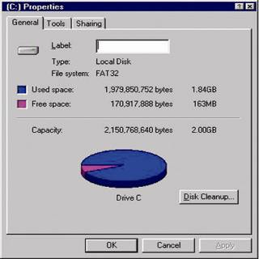
Figure 11-19 Make sure you have enough free hard drive space for Windows 2000/XP

Slide 33
Upgrade, Clean Install, Or Dual Boot?
Clean install: Windows 2000/XP put on a new drive
Clean install – erasing existing installations
Advantage: you start with a brand new operating system
Disadvantage: need to restore software and data
Decide between an upgrade and a clean install
Upgrades carry software and data into new environment
For certain OSs, an upgrade installation is faster
Creating a dual boot
At least two partitions on the hard drive are required
Only perform this operation when two OSs are needed

Slide 34
Hard Drive Partitions and File Systems
Minimum space required:
Windows XP: 2 GB for partition and 1.5 GB free
Windows 2000: 650 MB for partition; use > 2 GB
You can install OS on partition used by another OS
Consequence: the existing OS will be overwritten
Ensure that partitions on hard drive are adequate
Check disk usage with Fdisk or Disk Management
Select a file system
Choices: NTFS, FAT32, and FAT16
Needs, such as dual-booting, drive choice

Slide 35
Will the PC Join a Workgroup or Domain?
Use a workgroup for a network with < 10 nodes
Each account is set up on local computer
No centralized control
When to use a domain controller running an NOS
The network has more than 10 nodes
Centralized administrative control is needed
Things to know before beginning an installation:
Computer workgroup names for peer-to-peer network
Username, user password, computer and domain names
For TCP/IP networks, know how IP address is assigned

Slide 36
How Will the Installation Process Work?
If PC is not part of a network, install from setup CD
If PC is part of a network, you have two choices:
Install the OS from the Windows 2000/XP setup CD
Install OS from file server (files copied from setup CD)
Two options for automated installation:
Unattended installation (based on an answer file)
Drive imaging (or disk cloning)
Options for proceeding through the installation:
Custom, Typical, Express, or others

Slide 37
Final Checklist
A checklist summarizes the steps for preparation
Complete the checklist before starting installation

Slide 38
Table 11-4 Checklist to complete before installing Windows 2000/XP

Slide 39
Steps to Install Windows XP
General tips about installing Windows XP:
If booting from a CD, verify boot sequence
Disable the PnP feature of motherboard BIOS
Disable virus protection preventing boot sector changes
Select an installation program: Winnt.exe, Winnt32.exe
If internal CD drive not present, boot from external drive
If installing on a notebook, plug in the AC adapter

Slide 40
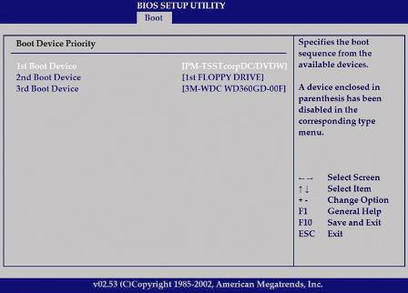
Figure 11-24 Use CMOS setup to verify the boot sequence looks to the optical drive before it checks the hard drive for an operating system

Slide 41
Windows XP Clean Install When an OS is Not Already Installed
Overview of instructions:
Boot from the Windows XP CD
Create and delete partitions; select OS partition
Format the partition using NTFS or FAT
Select your geographical location
Enter your name, organization name, product key
Enter computer name and Administrator password
Select the date, time, and time zone
Configure network settings (if connected to a network)
Enter a workgroup or domain name

Slide 42
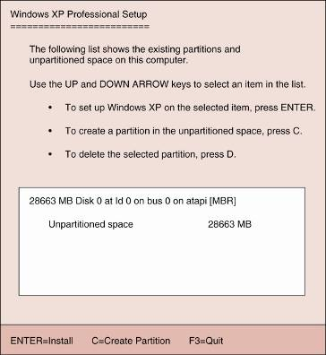
Figure 11-26 During Setup, you can create and delete partitions and select a partition on which to install Windows XP

Slide 43
Windows XP When an OS is Already Installed
Overview of instructions:
Close any open applications
Insert Windows XP CD to launch the opening window
Select the option to Install Windows XP
Select New installation
Read and accept licensing agreement
Pick up from Step 2 of regular clean installation

Slide 44
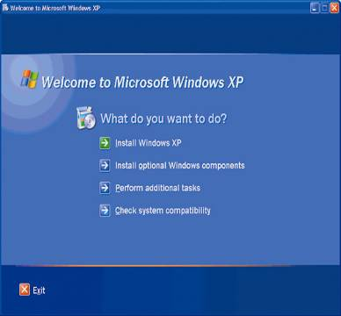
Figure 11-27 Windows XP Setup menu

Slide 45
Upgrade to Windows XP
Overview of instructions:
Clean up the hard drive
If necessary upgrade hardware and software
If BIOS is not current, flash your BIOS
Backup files and scan for viruses
If drive is compressed, uncompress the drive
Inset the Windows XP Upgrade CD
Select the upgrade type and
Select the partition to install Windows XP
Stop installation if serious compatibility issues arise

Slide 46
Dual Boot Using Windows XP
Begin installation like clean install over another OS
Choose to install XP on partition without an OS
Boot loader menu asks you to select an OS to start
Install the other OS first
Install Windows XP in a different partition
Windows XP is divided into two parts:
Boot initiation files are placed in the system partition
Remainder of OS is placed in the other partition
XP is aware of the applications under the other OS

Slide 47
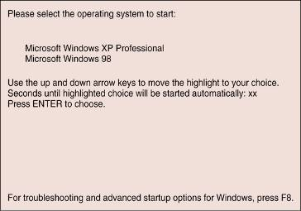
Figure 11-28 Menu displayed for a dual boot

Slide 48
After the Windows XP Installation
Preparing the system for use:
Activate Windows XP using Product activation
Verify you can access the network and the Internet
Verify all hardware works, install additional devices
Create user accounts for Windows XP
Install additional Windows components
Install applications
Verify system functions and backup system state
Uninstall or curtail functions of unneeded programs

Slide 49
Product Activation
Used by Microsoft to prevent software piracy
Product activation via the Internet:
Activate Windows dialog box appears after installation
Choose activation over Internet option
Windows XP sends numeric identifier to MS server
MS server sends certificate activating product
Activate Windows XP within 30 days of installation
Resolve suspected violations with MS representative

Slide 50
Update Windows
MS Web site offers patches, fixes, updates, advice
How to install updates
Connect to Internet and start Windows Update
ActiveX controls scan system and report needed items
Respond to installation prompt
Updates will be downloaded and installed
Windows XP Service Pack 2 (SP2)
Offers great benefits, including Windows Firewall
Where to configure automatic updates
Automatic Updates tab of System Properties dialog

Slide 51
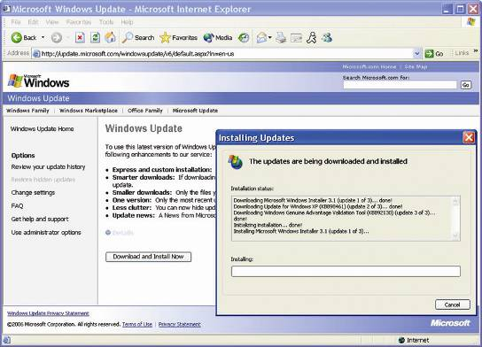
Figure 11-32 Installing updates to Windows XP

Slide 52
Steps to Install Windows 2000
Procedures: clean install, upgrade, and dual-boot
Installation process similar to that for Windows XP
There are some differences
Installation programs used by Windows 2000/XP:
16-bit Winnt.exe program, or the 32-bit Winnt32.exe

Slide 53
Clean Installation
Overview of instructions:
Boot PC from setup CD or four setup disks
Select a partition and a file system
Enter your name, company name, and product key
Enter date and time, and administrator password
If applicable, configure Networking Settings
Remove Windows 2000 CD/disk and reboot
If applicable, complete network configuration

Slide 54
Clean Install When the Hard Drive has an Operating System Installed
Overview of instructions
Insert the Windows 2000 CD in the CD-ROM drive
When prompted to upgrade existing OS, answer “No”
Click Install Windows 2000
Respond to Windows Setup Wizard
After reboot, installation is like a regular clean install

Slide 55
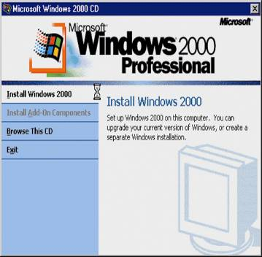
Figure 11-37 Windows 2000 Setup window

Slide 56
Upgrade Installation
First step: prepare for installation (like Windows XP)
Overview of instructions
Insert the Windows 2000 CD in the CD-ROM drive
Respond to issues raised (if any) in Report phase
Allow PC to reboot and enter two-part Setup phase
The first part of setup takes place in Text mode
Windows registry and profile are moved to old OS folder
Allow PC to reboot and continue Setup in GUI mode
Registry is updated and application DLLs migrated
After system reboots again, retrieve updates

Slide 57
Summary
User mode: comprises user, applications, and various subsystems
Kernel mode: comprises HAL and Executive services
Workgroups use a peer-to-peer networking model
Domains use a client-server networking model
Two types of partitions: primary and extended

Slide 58
Summary (continued)
Formatting: process of creating a file system on a disk
Two file systems: NTFS and FAT
Proper preparation improves the process of installing an OS
Major installation procedures: clean install, upgrade, and dual-boot installation
Windows XP and Windows 2000 use the same installation programs

